Slide 1
Big Data Linguistics
W205.1 Group Project
Week 15 Presentation: 12/18/2015
Brandon Shurick & Jared Maslin

Slide 2
User Case & Motivation
Traveling to a foreign country soon?
How will you communicate with native citizens?
What tools are available to help you?
Options available today fall into a few basic buckets:
Language software (i.e., Dragon, Rosetta Stone)
Coursework from an online institution or a university
Educational books
Common themes -- Time-consuming and often expensive
Are there any other alternatives?

Slide 3
Our Solution
Objective:
To offer an approachable platform for self-driven learning of a new language, directly from native writers/speakers
For our prototype, we chose to focus on Spanish
Traditional learning methods often spend too much time on conjugation/syntax, which is often unimportant
Real-time social media data can quickly and effectively identify common words and phrases that an average person can digest in a reasonable period of time
Gain relevant information about the language and its native speakers in an easily accessible manner

Slide 4
The Approach
In order to address this gap in language education, we chose two data sources to start with:
Twitter API
A proxy for informal / conversational speech
Store and retrieve vast amounts of data based on the language of each tweet
Analyze and summarize data for prioritizing to the user
Wikipedia public data (available via EBS volume)
More formal language in Wikipedia documents
Public datasets available to summarize popular searches by language/location

Slide 5
Laying the Foundation
Created a streaming Twitter application (27+ million tweets)
Loaded a stream of Spanish-language tweets into local files, then compiling and loading data to HDFS every hour
Increment real-time word counts in Redis
Attach EBS volume with 787k Spanish Wikipedia documents
ETLs to load tweet and Wikipedia data from raw formats
Combined table with words from documents across all data sources and languages

Slide 6
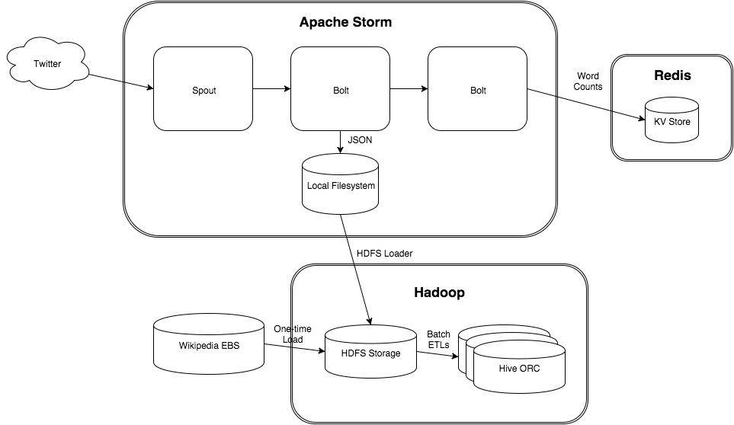
Architecture

Slide 7
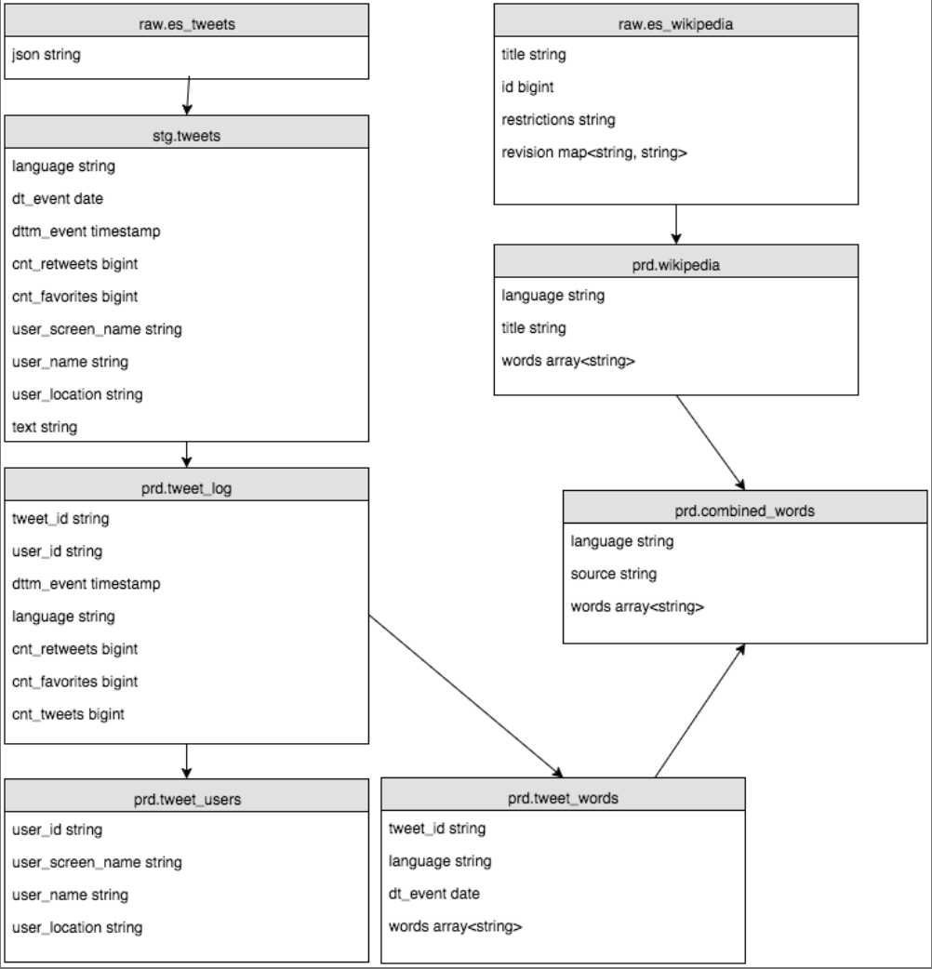
Our ERD At a Glance

Slide 8
Main Challenges
Handling unicode data from the Spanish-language tweets
Parsing out words & characters that shouldn't be included
URLs, hashtags, usernames (tweets)
Markup language code (wikipedia)
Parsing different formats (JSON and XML)
Running on a single node & minimizing cost

Slide 9
Next Steps
Linguistics analysis and presentation layer with emphasis on analysis for developing language instruction
Consider other languages to include going forward
Current model was designed to shift easily from one language to the next
Extend to other data sources
Model is also extendible to additional data sources (ex: Facebook, web as a corpus, Google news, academic journals)

Slide 10
Questions?

